Slide 1
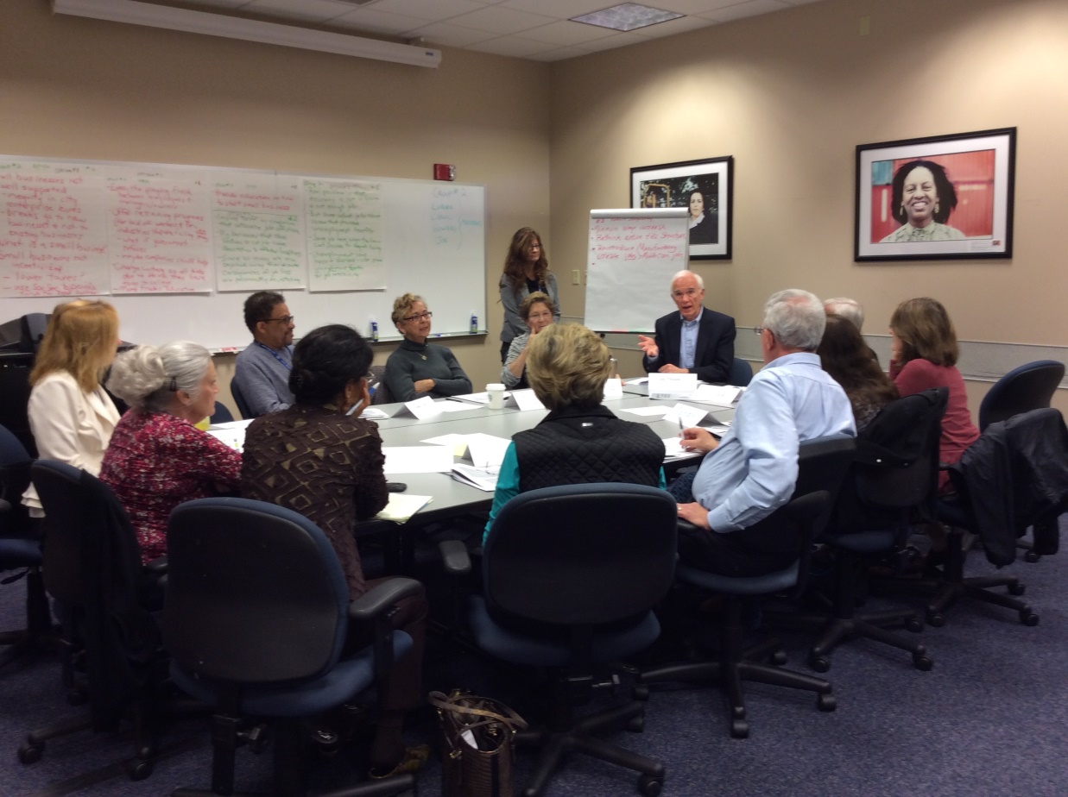
MODERATING DELIBERATIVE FORUMS:
AN INTRODUCTION

Slide 2
NATIONAL ISSUES FORUMS
A nationwide network that promotes deliberation on tough public issues.
Non-partisan, non-profit
Libraries, K-12 schools, colleges and universities, community organizations, senior centers, and more
NIFI publishes issue guides, connects conveners and facilitators, and works with the Kettering Foundation to report forum results to policymakers

Slide 3
WHAT WE’LL COVER TODAY
What is deliberation and why it matters
The 4 segments
of an NIF forum
The moderator’s role
Strategies & sample questions for each segment
Frequently asked questions
Wrapping up & resources

Slide 4
“DELIBERATION” (What It Is and Why It Matters)
Deliberation is a form of political discourse where people:
Tackle issues that are not easily solved
Face up to issues where people disagree
Look at difficult issues with an open mind
Listen carefully to different perspectives
Weigh the benefits and trade-offs of different courses of action
Think about what matters most to them—what they really value when they can’t have everything
Deliberation matters because democracy depends on citizens coming together and making well-thought-out decisions on what we can do together to solve tough problems
Notes:
NOTE: Include a conversation about: "what is a trade-off" - to show that this is more than "pros and cons" -- but the question we use in the Writers Group is: If this action/option worked PERFECTLY, what might the downside be?

Slide 5
DELIBERATION—What It’s Not
Deliberation is NOT:
Debate—where each side states a specific opening position and argues against the opposing view
Discussion—where people examine an issue, but do not confront choices or weigh benefits and trade-offs
Advocacy—where people enlist supporters and rally for agreed-upon courses of action
Making a “To Do” List—where people identify a few broadly-acceptable ideas and organize or advocate for them
All of these have a role in a democracy, but deliberation requires that people wrestle with different approaches and perspectives

Slide 6
WHY DELIBERATE
Deliberating is necessary when a problem requires people
to make an ethical decision. The questions we wrestle with are:
“What should we do?”
“Which solutions reflect my values—the things I care most about?”
“Could there be unintended consequences I haven’t thought about?”
“No solution is perfect. Am I willing to accept the trade-offs of what I decide?”
Deliberation happens all the time:
We routinely deliberate about personal, family, and work decisions.
It’s essential for our politics as well
Notes:
NOTE: Include a conversation about: "what is a trade-off" - to show that this is more than "pros and cons" -- but the question we use in the Writers Group is: If this action/option worked PERFECTLY, what might the downside be?

Slide 7
THE COMPONENTS OF THE NIF DELIBERATIVE FORUM
The moderator of an NIF forum is part of an ecosystem designed to foster deliberation. The ecosystem includes:
An issue guide―especially the choice framework
The forum design
One or more moderators who understand their role
Participants who understand the purpose of a deliberative forum and the importance of weighing options and trade-offs
Notes:
NOTE: Include a conversation about: "what is a trade-off" - to show that this is more than "pros and cons" -- but the question we use in the Writers Group is: If this action/option worked PERFECTLY, what might the downside be?

Slide 8
1. THE ISSUE GUIDE
Presents a framework and context for deliberating on an issue
Lays out 3 or 4 ways of approaching the issue, each based on values people care about, e.g.: being fair, having freedom, living a safe, secure life, being responsible, being able to make decisions for yourself.
Describes proposals for change associated with each choice, including their benefits and trade-offs
Poses questions that encourage participants to deliberate and reflect on what they are hearing from others.
Notes:
NOTE: Include a conversation about: "what is a trade-off" - to show that this is more than "pros and cons" -- but the question we use in the Writers Group is: If this action/option worked PERFECTLY, what might the downside be?

Slide 9
2. FORUM DESIGN―FOUR KEY ELEMENTS Participants are more likely to deliberate when they have a chance to:
THINK about the distinctive goal of deliberative forums and consider the ground rules for the conversation
SHARE their personal stakes and experiences and LISTEN to those of the other participants
WEIGH the options and proposals in the issue framework and wrestle with the benefits and trade-offs
REFLECT on their deliberations, identifying points where there’s common ground and where work remains.
REFLECTIONS may include identifying points of agreement, points where participants have second thoughts after hearing from others, areas where people are undecided, remaining questions, and pinpointing trade-offs people are (or are not) willing to make
Notes:
NOTE: Include a conversation about: "what is a trade-off" - to show that this is more than "pros and cons" -- but the question we use in the Writers Group is: If this action/option worked PERFECTLY, what might the downside be?

Slide 10
2. FORUM DESIGN― HOW SHOULD I USE THE TIME?
INTRODUCTION & GROUNDRULES:
Identify yourself. Explain what deliberation is and why it matters
Introduce ground rules. Introduce the issue . Moderators often
use NIF starter videos to do this 10 min
PERSONAL STAKE: Time for people to share their personal
experiences with the issue and listen to the experiences of others 15 min
WEIGH THE OPTIONS: Time for people to weigh benefits
and trade-offs of each option. (20 min. each) 1 hour
REFLECTIONS: Identify areas of agreement, second thoughts,
acceptable trade-offs, areas of tension, questions. Include time
for participants to complete QUESTIONNAIRES which help NIFI
report on forums. For many, completing the questionnaire is a last
chance to deliberate. 25 min
Most forums take 1 ½ to 2 hours
Notes:
Is there a questionnaire for these forums and how will the results be used?

Slide 11
3. THE MODERATOR’S ROLE― SEVEN RESPONSIBILITIES
Explain the purpose of deliberative forums and set ground rules. Emphasize listening and reconsidering initial views
Encourage participants to talk about their personal stake—why this issue matters to them, their personal experiences with it
Insure all options are considered seriously.
If necessary, refer participants back to the issue guide to talk about tradeoffs that aren’t being considered
Keep track of time: All segments of the forum design are important
Stay neutral. Avoid being an expert.
Make sure participants reflect on what they’ve heard
Identifying points of tension and uncertainly is just as important as identifying area of agreement
Notes:
What role do you typically take in a conversation with friends? How will this experience be different for you?

Slide 12
4. THE RESPONSIBILITIES OF THE PARTICIPANTS
Understand the purpose of the forum—to listen to others, deliberate on choices
Keep an open mind
Commit to deliberating seriously, weighing each option’s benefits and trade-offs, considering the views and experiences of others
Disagree with curiosity, not hostility
Focus on learning and deliberating―not convincing others of their point of view
Take part

Slide 13
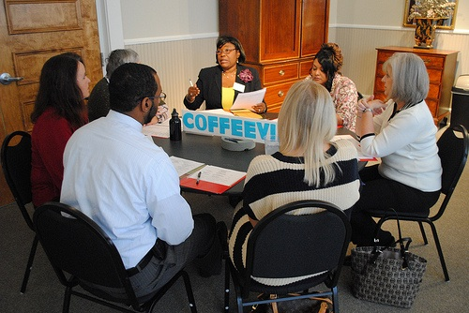
STRATEGIES AND SAMPLE QUESTIONS FOR EACH FORUM SEGMENT

Slide 14
WHAT ARE SOME GROUND RULES TO CONSIDER?
Listen to others. Listening is as important as speaking.
Consider each approach fairly, looking at its benefits and its trade-offs
Everyone is encouraged to participate. No one or two individuals should dominate.
It’s ok to disagree, but do so with curiosity, not hostility. Learning more about how others think is one of the most interesting parts of a forum.
Keep an open mind. Avoid coming to conclusions until we’ve deliberated on all the options.
Others?

Slide 15
WHAT ARE SOME GOOD QUESTIONS FOR THE PERSONAL STAKE?
What interests you about this issue?
How has this issue affected you, your family, or your community?
When you think about this issue, what bothers you?
When you think about this issue, what kinds of values and goals are most important to you?
How does this problem affect the people, places, and ideas that are most important to you?

Slide 16
WHAT KINDS OF QUESTIONS FOSTER DELIBERATION ON THE OPTIONS?
What do you like about this option?
What worries you about it?
How might people who have other life experiences see this option?
Could this option have any unintended consequences?
Do you see any gray areas?
Notes:
Ask people to hold off on their judgments until the forum has looked at all the options
Point people to the trade-offs listed in the guide

Slide 17
MORE QUESTIONS THAT FOSTER DELIBERATION ON THE OPTIONS
[When people like an option]
What are the trade-offs? Are you willing to live with them?
Are there ways this idea could go wrong or be taken too far?
[When people reject an option]
Do you see any benefits in this approach even if you have concerns about it?
What would people who like this option say?
Are there areas we share values and goals (e.g., being fair or making our community safer), but we differ on how to do it?
Notes:
Ask people to hold off on their judgments until the forum has looked at all the options
Point people to the trade-offs listed in the guide

Slide 18
WHEN SHOULD I INTERVENE?
As much as possible, participants should take responsibility for the deliberation. Moderators should intervene when:
Everyone quickly agrees with or rejects an option.
Not enough attention is being paid to the cost, trade-offs, and difficulties of an option or action.
One individual is dominating.
The time allocated for that section is used up.

Slide 19
IF I NEED TO INTERVENE . . .
Go back to the issue guide:
The guides include questions and trade-offs for each choice. Do not ”play devil’s advocate.”
Ask questions such as
“What would opponents (or supporters) of this option say?”
“Do you know anyone who would like (or dislike) this option? What would that person say?”

Slide 20
HOW DO I KNOW IF PARTIPANTS ARE DELIBERATING?
Participants acknowledge the difficulty of solving the problem
Participants admit they’re having second thoughts on some aspect of the problem or the proposals
The group is exchanging a wide range of views
People talk about what really matters to them—rather than quoting what they’ve read or heard on TV;
Participants acknowledge the risks, costs, and downsides of the actions being supported;
Disagreements are aired in the spirit of looking for shared understanding and common ground
What are other signs of deliberation?

Slide 21
WHAT KINDS OF QUESTIONS PROMPT PRODUCTIVE CLOSING REFLECTIONS?
Now that we have deliberated about these options, are there ideas or viewpoints you hadn’t considered before?
Did you have any second thoughts about any of your initial views?
What trade-offs are you personally willing to accept? What about the group as a whole?
Can you identify any tensions that came up during the forum?
What questions remain? What work do we still need to do? Who else do we need to hear from?
How has what you heard affected your thinking about what you might do? About what the community might do? About what we want our elected officials in Washington to do?
Notes:
EMI: Knowing WHY they are doing these forums and “what’s next” with the info that comes from them will be helpful here.

Slide 22
DELIBERATION IN REAL LIFE
Deliberation is the goal, but it doesn’t occur throughout the forum
Don’t expect people to make up their minds or completely reverse their initial views. Deliberation occurs intermittently and over time.
People may also explain, elaborate or present counter arguments. These are normal parts of a forum and often prompt deliberation by others.
THE PERSONAL STAKE is a time for sharing stories and perspectives, not deliberating.
When discussing THE OPTIONS, some participants may not deliberate openly. They may do it internally or even after the forum is over.
During the REFLECTIONS, participants review their deliberations. Encourage them to reflect how they weighed the options, new insights, and second thoughts. It’s important for moderators to remain neutral. Avoid pushing for a consensus.
Notes:
EMI: Knowing WHY they are doing these forums and “what’s next” with the info that comes from them will be helpful here.

Slide 23
FREQUENTLY ASKED QUESTIONS
1. Does this seem like a lot?
4. What if people want more facts?
5. How can I localize the issue?
2. How are issue guides developed?
6. What’s next?
3. Can people combine options?

Slide 24
FAQ # 1: DOES THIS SEEM LIKE A LOT?
Get some help
Use the video discussion starters available at nifi.org. These can help you get everyone focused on the choices and trade-offs
Divide up the responsibility for moderating, timekeeping, handling logistics, taking notes and reporting
Use different moderators for different segments—one for the introduction and closing reflections, while one or two others focus on the options.
Remember that the forum belongs to the participants. To the degree possible, let them take the lead.
Consider the 4 x 4 plan.

Slide 25
FAQ # 1: GET HELP CONVENING
ENLIST A PARTNER ORGANIZATION:
Look for local organizations that bring people together on a regular basis. These include clubs, senior centers, religious groups, and book clubs
It can be a great partnership—they convene participants; you moderate the forum
CONVENING A FORUM ON YOUR OWN? TRY THE 4 x 4
One person takes responsibility for logistics: the room, refreshments, etc.
One will be the recorder.
Two will share the responsibility of moderating.
Each of the four recruits four people & follows up to encourage them to attend

Slide 26
FAQ #2: HOW ARE ISSUE GUIDES DEVELOPED?
Prepared by NIFI and Kettering
Extensive research on how typical citizens approach issues
Extensive pretesting & review for balance
Options designed to reflect deep-seated values—what matters most to people
Options include specific policy ideas—benefits and trade-offs are spelled out
Options designed to help people take a fresh look at an issue
Not the typical left-right divisions, not based on legislative proposals

Slide 27
FAQ # 3: CAN PEOPLE COMBINE THE OPTIONS?
In most deliberative forums, people tend to like some elements from each of the options. This can be a mark of a good exchange of ideas and looking for common ground.
However you may want to ask:
How realistic is it to think we can do all these things?
Can we afford to do all these things?
Are there conflicts or tensions if we try to do all these things?
If we don’t have the money or time to do all of these things, which are the most important to you?

Slide 28
FAQ # 4: WHAT IF PEOPLE WANT MORE FACTS?
Sometimes, it’s useful to suggest that people explore specific factual questions on their own after the forum. Having people leave the forum with questions can be a sign they are deliberating.
However you may want to ask:
Why is this piece of information important to you?
How might your views change depending on what you find out?
If the information is not available or it’s disputed, how would that affect your thinking?

Slide 29
FAQ # 5: HOW CAN THE ISSUE BE LOCALIZED?
Nearly all issues have both local and national implications, and considering both is an important part of deliberation.
You may want to think about whether:
It would be helpful to identify a few local statistics prior to the forum.
There are people present who can talk about how the issue is emerging locally.
There are participants who have lived in other communities who can offer important comparisons.

Slide 30
FAQ # 6: WHAT’S NEXT NIF forums are a start
Many participants want to talk more
Look for issue guides on related topics (e.g., healthcare, obesity, end of life choices, etc.)
Conduct more forums, looking for ways to include perspectives that were not included earlier
Consider inviting local elected officials and their staff, local journalists to additional forums
Others want to join with neighbors to act
Deliberate the choices for acting locally
Look for community “assets” so citizens can help solve problems
Consider ways to build deliberation into community conversations long term

Slide 31
WRAPPING UP: HERE’S WHAT MATTERS MOST
INVITE A DIVERSE GROUP This brings different experiences and life stories into the deliberation.
READ THE GUIDE BEFORE THE FORUM. TAKE TIME TO PREPARE YOURSELF TO PRESENT THE OPTIONS FAIRLY. If you understand the values and tensions presented in the guide, you’ll be able to help participants consider each option with its best foot forward.
SET A TONE WHERE PARTICIPANTS ARE ENCOURAGED TO WORK THROUGH TENSIONS AND TRADE-OFFS. Sometimes participants want to avoid tough questions and trade-offs, but honestly facing up to them is what makes a forum deliberative — and rewarding!

Slide 32
WHAT RESOURCES ARE AVAILABLE?
Issue guides, moderator guides, questionnaires, and additional moderator development materials are available at www.nifi.org.
Some materials are free. Others are available at very reasonable cost
Download short videos presenting options on many issues at: https://vimeo.com/nifi/vod_pages
Prepare by participating in an online forum at https://www.nifi.org/en/common-ground-action. It’s a great way to familiarize yourself with deliberative forums and see how deliberation may go on your issue.
Kettering Foundation: www.kettering.org
National Issues Forums: www.nifi.org
Notes:
ar

